Slide 1

Chapter 4 Introduction to Cascading Style Sheets (CSS) - Part 2
IT 210 Web-Based Design

Slide 2
O b j e c t i v e s
By the end of this chapter, you’ll be able to:
Specify element backgrounds and colors.
Understand the box model and how to control margins, borders and padding.
Use style sheets to separate presentation from content.

Slide 3
Outlines for part 2
Backgrounds.
Element Dimensions
Box Model.
Drop-Down Menus.

Slide 4
Backgrounds
CSS can control the backgrounds of block-level elements by adding:
Colors
Images
Example (4) adds a corporate logo to the bottom-right corner of the document. This logo stays fixed in the corner even when the user scrolls up or down the screen.

Slide 5
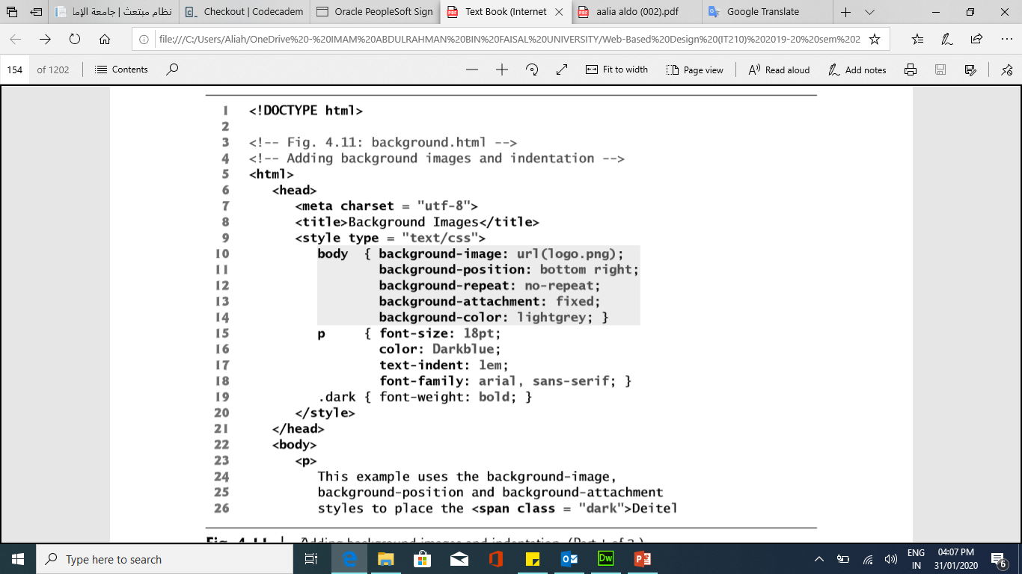
Backgrounds Example (4)
Notes:
<html>
<head>
<title>Background Images</title>
<style type = "text/css">
body { background-image: url(logo.png);
background-position: bottom right;
background-repeat: no-repeat;
background-attachment: fixed;
background-color: lightgrey; }
p { font-size: 18pt; color: Darkblue; text-indent: 1em;
font-family: arial, sans-serif; }
</style>
</head>
<body>
<p> This example uses the background-image, background-position and background-attachment styles to place the logo in the bottom-right corner of the page </p>
</body>
</html>

Slide 6
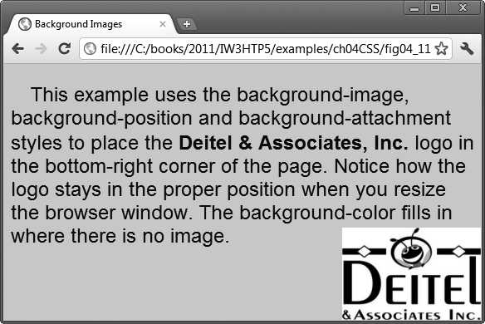
Backgrounds Example (4)
Fig. 4.11 | Adding background images and indentation

Slide 7
Backgrounds
Value | Description | Value
background-color | Specifies the background color to be used | RGB format (decimal or hex)
background-image | Specifies URL background images to be used | URL
background-position | Specifies the position of the background images | top, bottom, center, left and right vertical , horizontal
background-size | Specifies the size of the background images

Slide 8
Backgrounds
Value | Description | Value
background-repeat | Specifies how to repeat the background images | no-repeat, repeat(default), repeat-x (horizontally), repeat-y(vertically)
background-attachment | Specifies whether the background images are fixed or scrolls with the rest of the page | Scroll (default), fixed

Slide 9
Element Dimensions
CSS rules can specify the actual dimensions of each page element.
Example (5) demonstrates how to set the dimensions of elements.

Slide 10
Element Dimensions
Specifying the width and height of an Element
Dimensions of elements on a page can be set with CSS by using properties height and width
The height and width of a content area can be set in pixels or percentage.

Slide 11
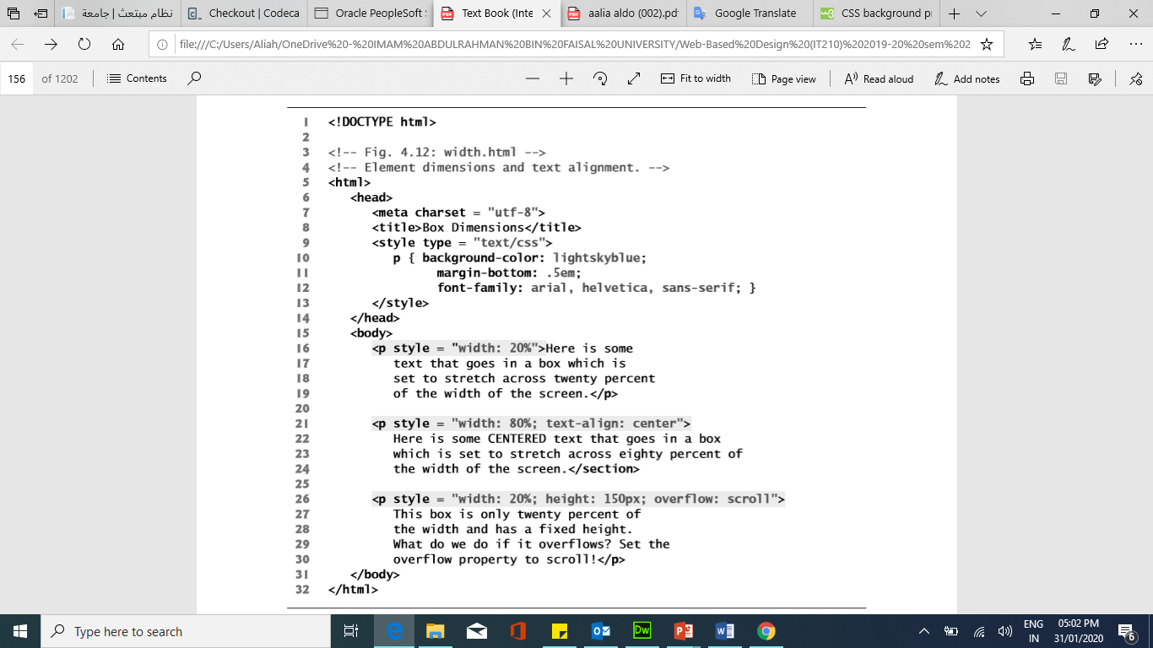
Element Dimensions Example (5)
Notes:
<html>
<head>
<title>Box Dimensions</title>
<style type = "text/css">
p { background-color: lightskyblue;
margin-bottom: .5em; font-family: arial;}
</style>
</head>
<body>
<p style = "width: 20%"> Here is some text that goes in a box which is set to stretch across twenty percent of the width of the screen. </p>
<p style = "width: 80%; text-align: center"> Here is some CENTERED text that goes in a box which is set to stretch across eighty percent of the width of the screen.</p>
<p style = "width: 20%; height: 150px; overflow: scroll"> This box is only twenty percent of the width and has a fixed height. What do we do if it overflows? Set the overflow property to scroll!</p>
</body>
</html>

Slide 12
Element Dimensions Example (5)
Notes:
<html>
<head>
<title>Box Dimensions</title>
<style type = "text/css">
p { background-color: lightskyblue;
margin-bottom: .5em; font-family: arial;}
</style>
</head>
<body>
<p style = "width: 20%"> Here is some text that goes in a box which is set to stretch across twenty percent of the width of the screen. </p>
<p style = "width: 80%; text-align: center"> Here is some CENTERED text that goes in a box which is set to stretch across eighty percent of the width of the screen.</p>
<p style = "width: 20%; height: 150px; overflow: scroll"> This box is only twenty percent of the width and has a fixed height. What do we do if it overflows? Set the overflow property to scroll!</p>
</body>
</html>

Slide 13
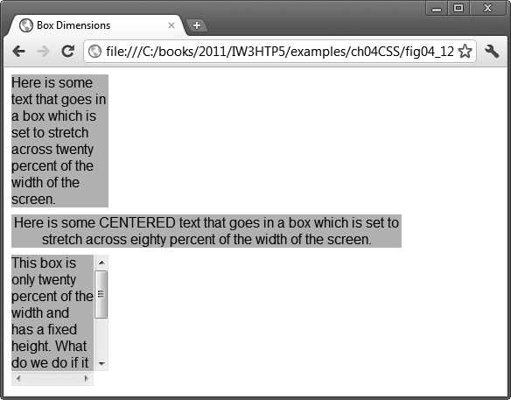
Element Dimensions Example (5) in the browser

Slide 14
Element Dimensions
Overflow Property and Scroll Bars
Problem with setting both vertical and horizontal dimensions of an element
Content might sometimes exceed the set boundaries, in which case the element must be made large enough for all the content to fit.
Can set the overflow property to scroll, which adds scroll bars if the text overflows the boundaries set for it.
The overflow property can be set to display, hide, or scroll, and dictates how HTML will render content that overflows its parent’s content area.

Slide 15
Box Model
The box model comprises a set of properties used to create space around and between HTML elements.
Borders surround the content area and padding of an element. The color, style, and thickness of a border can be set with CSS properties.
border is controlled using the properties:
border-width: thin, medium or thick
border-color:
border-style: none, hidden, dotted, dashed, solid, double, groove, ridge, inset and outset

Slide 16
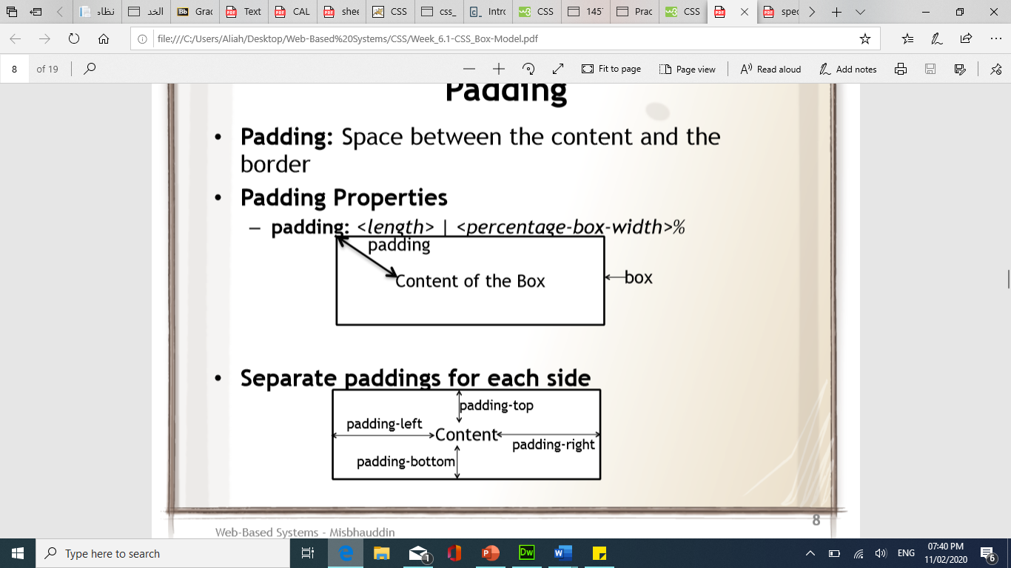
Box Model
Padding is the space between the content area and the border. It can be set in pixels or percent.
Padding be set for each side of the box by using padding-top, padding-right, padding-bottom, and padding-left
P { padding: 40px 60 px 30px 40px;}

Slide 17
Box Model
Margin is the amount of spacing outside of an element’s border.
Margins for individual sides of an element can be specified by using margin-top, margin-right, margin-bottom and margin-left

Slide 18
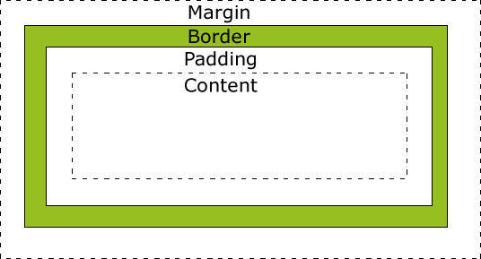
Box Model
Fig. 4.13 | Box model for block-level elements.

Slide 19
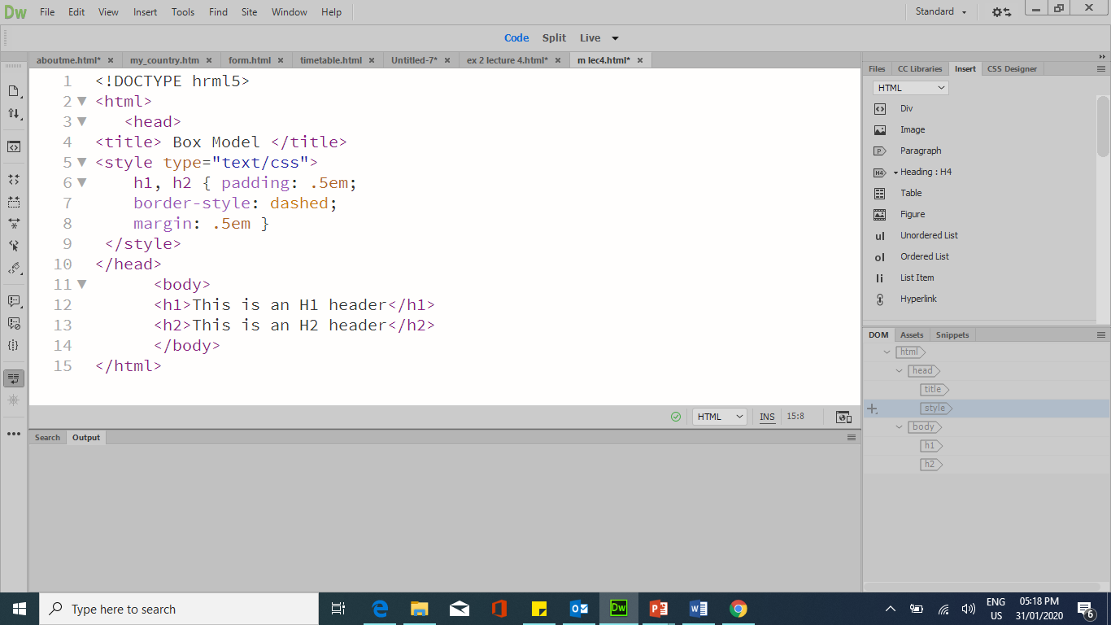
Box Model and Text Flow Example (5)
Notes:
<!DOCTYPE hrml5>
<html>
<head>
<title> Box Model </title>
<style type= "text/css">
h1, h2 { padding: .5em;
border-style: dashed;
margin: .5em }
</style>
</head>
<body>
<h1>This is an H1 header</h1>
<h2>This is an H2 header</h2>
</body>
</html>

Slide 20
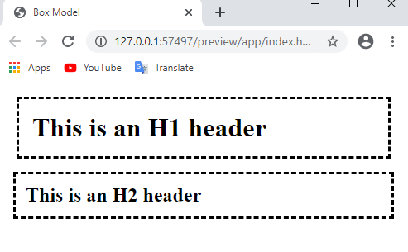
Box Model and Text Flow Example (5) in the browser

Slide 21
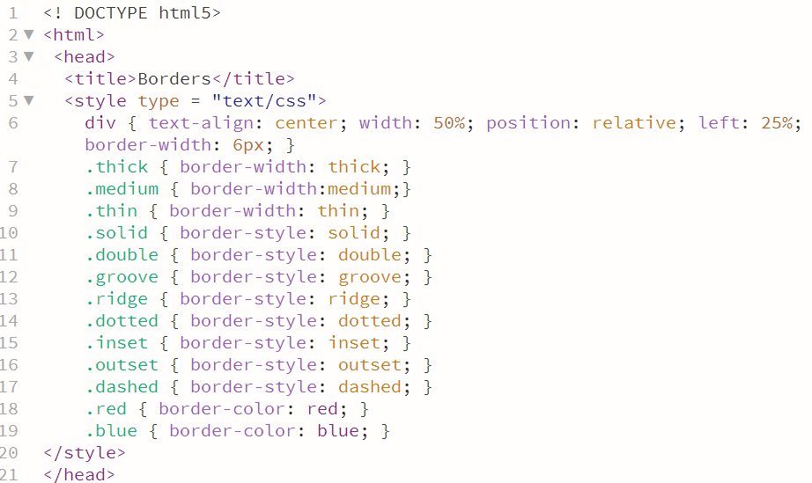
Box Model and Text Flow Example (6)
Notes:
<! DOCTYPE html5>
<html>
<head>
<title>Borders</title>
<style type = "text/css">
div { text-align: center; width: 50%; position: relative; left: 25%; border-width: 6px; }
.thick { border-width: thick; }
.medium { border-width:medium;}
.thin { border-width: thin; }
.solid { border-style: solid; }
.double { border-style: double; }
.groove { border-style: groove; }
.ridge { border-style: ridge; }
.dotted { border-style: dotted; }
.inset { border-style: inset; }
.outset { border-style: outset; }
.dashed { border-style: dashed; }
.red { border-color: red; }
.blue { border-color: blue; }
</style>
</head>
<body>
<div class = "solid">Solid border</div><hr>
<div class "double">Double border</div><hr>
<div class = "groove"> Groove border</div><hr>
<div class = "ridge">Ridge border</div><hr>
<div class = "dotted">Dotted border</div><hr>
<div class = "inset">Inset border</div><hr>
<div class = "thick dashed">Thick dashed border</div><hr>
<div class = "thin red solid">Thin red solid border</div><hr>
<div class = "medium blue outset">Medium blue outset border</div> </body> </html>

Slide 22
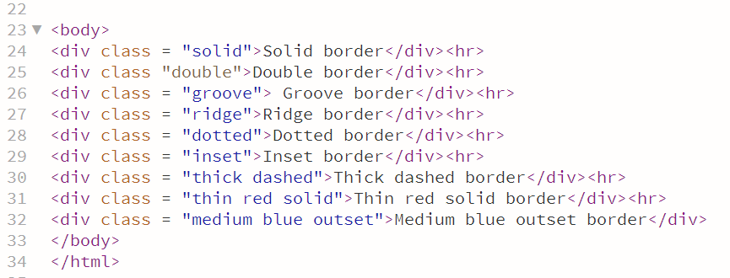
Box Model and Text Flow Example (6)

Slide 23
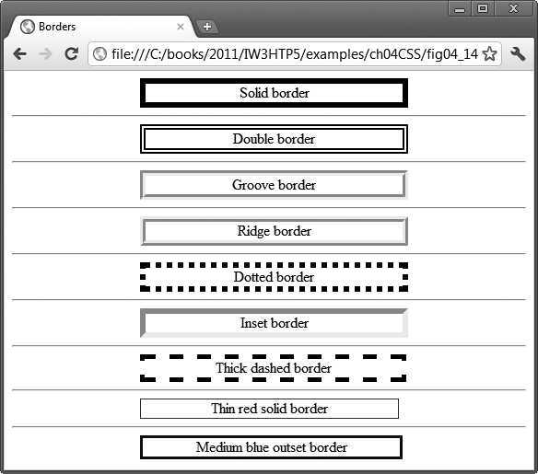
Box Model and Text Flow Example (6)
Fig. 4.14 | Borders of block-level elements.

Slide 24
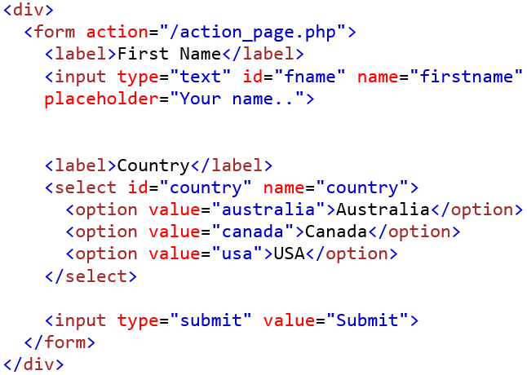
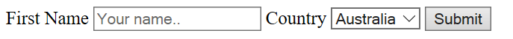
CSS for FORM Elements
HTML Code:
Output:
Notes:
<!DOCTYPE html>
<html>
<style>
input[type=text], select {
width: 100%;
padding: 12px 20px;
margin: 8px 0;
border: 1px solid #ccc;
border-radius: 4px;
box-sizing: border-box;
}
input[type=submit] {
width: 100%;
background-color: #4CAF50;
color: white;
padding: 14px 20px;
margin: 8px 0;
border-radius: 4px;
cursor: pointer;
}
input[type=submit]:hover {
background-color: #45a049;
}
div {
border-radius: 5px;
background-color: #f2f2f2;
padding: 20px;
}
</style>
<body>
<h3>Using CSS to style an HTML Form</h3>
<div>
<form action=" ">
<label for="fname">First Name</label>
<input type="text" id="fname" name="firstname" placeholder="Your name..">
<label for="country">Country</label>
<select id="country" name="country">
<option value="australia">Australia</option>
<option value="canada">Canada</option>
<option value="usa">USA</option>
<option value="Ksa">KSA</option>
</select>
<input type="submit" value="Submit">
</form>
</div>
</body>

Slide 25
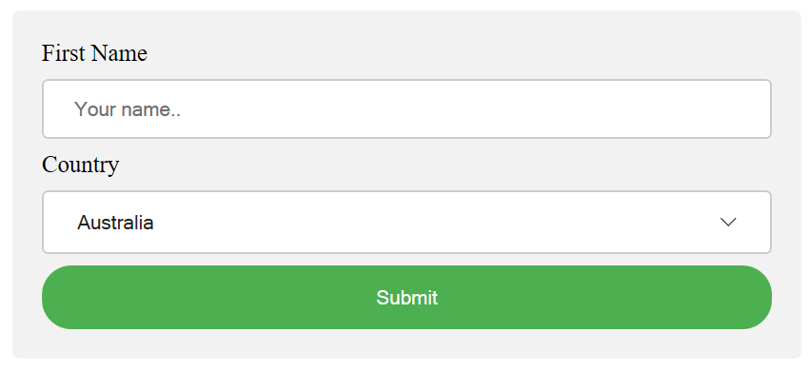
CSS for FORM Elements
Same HTML Code with this output:
How?

Slide 26
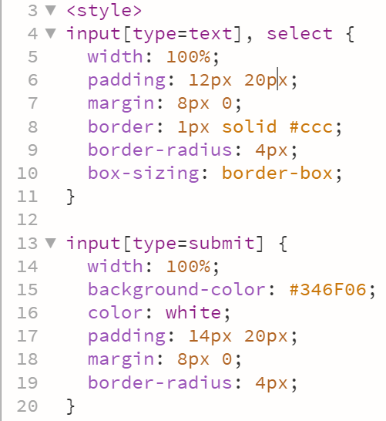
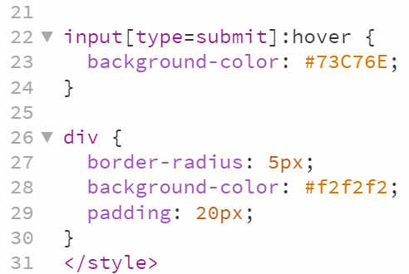
CSS for FORM Elements
CSS code:
Notes:
<!DOCTYPE html>
<html>
<style>
input[type=text], select {
width: 100%;
padding: 12px 20px;
margin: 8px 0;
display: inline-block;
border: 1px solid #ccc;
border-radius: 4px;
box-sizing: border-box;
}
input[type=submit] {
width: 100%;
background-color: #4CAF50;
color: white;
padding: 14px 20px;
margin: 8px 0;
border: none;
border-radius: 4px;
cursor: pointer;
}
input[type=submit]:hover {
background-color: #45a049;
}
div {
border-radius: 5px;
background-color: #f2f2f2;
padding: 20px;
}
</style>
<body>
<h3>Using CSS to style an HTML Form</h3>
<div>
<form action="/action_page.php">
<label for="fname">First Name</label>
<input type="text" id="fname" name="firstname" placeholder="Your name..">
<label for="country">Country</label>
<select id="country" name="country">
<option value="australia">Australia</option>
<option value="canada">Canada</option>
<option value="usa">USA</option>
</select>
<input type="submit" value="Submit">
</form>
</div>
</body>
</html>

Slide 27
Thank you

Slide 28
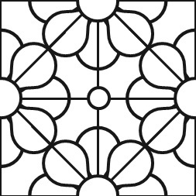
Extra slides

Slide 29
the flow of elements
A browser will render the elements of an HTML document that has no CSS from left to right, top to bottom, in the same order as they exist in the document. This is called the flow of elements in HTML.
CSS includes properties that change how a browser positions elements. These properties specify where an element is located on a page, if the element can share lines with other elements, and other related attributes.
properties for adjusting the position of HTML elements in the browser:
_{• position}
_{• display}
_{• z-index}
_{• float}

Slide 30
Floating
Floating Elements:
allows you to move an element to one side of the screen; other content in the document then flows around the floated element.

Slide 31
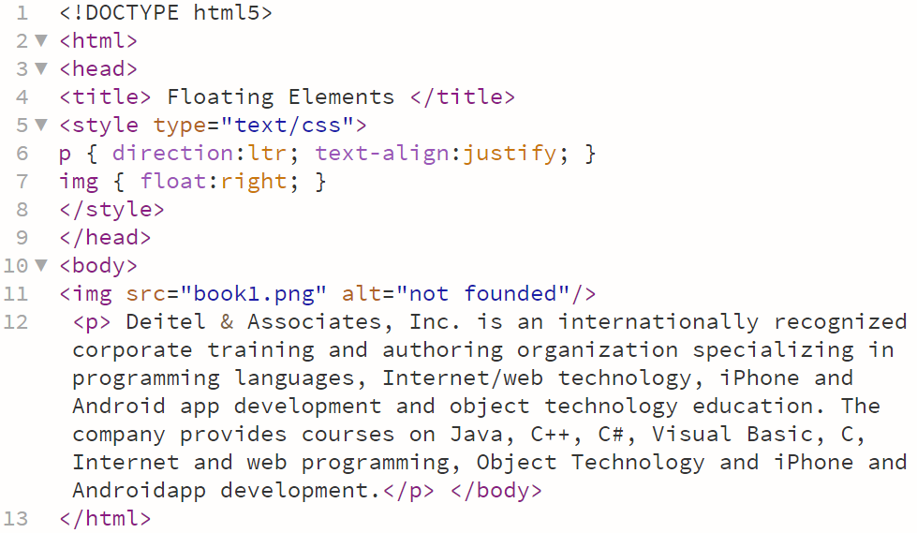
Example (7) Floating Elements
Notes:
<!doctype html>
<html>
<head>
<title> Floating Elements </title>
<style type="text/css">
p { direction:ltr; text-align:justify; }
img { float:right; }
</style>
</head>
<body>
<img src="../OneDrive - IMAM ABDULRAHMAN BIN FAISAL UNIVERSITY/Web-Based Design (IT210) 2019-20 sem 2/week 3/worksheet 1 - lab 2/book1.png" alt="not founded"/>
<p> Deitel & Associates, Inc. is an internationally recognized corporate training and authoring organization specializing in programming languages, Internet/web technology, iPhone and Android app development and object technology education. The company provides courses on Java, C++, C#, Visual Basic, C, Internet and web programming, Object Technology and iPhone and Androidapp development.</p> </body>
</html>

Slide 32
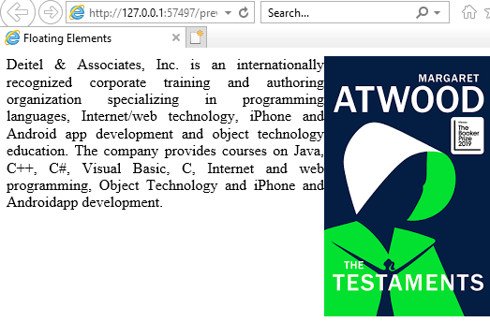
Example (7) Floating Elements

Slide 33
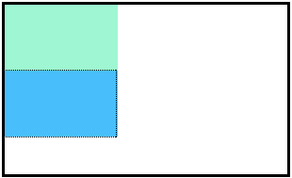
Position
Block-level elements like these boxes create a block the full width of their parent elements, and they prevent other elements from appearing in the same horizontal space. The boxes in the image were created with the following CSS:
.boxes {
width: 120px;
height: 70px;
}
and the following HTML:
<div class="boxes"></div>
<div class="boxes"></div>

Slide 34
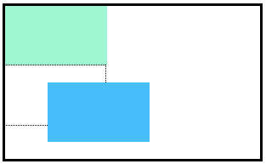
Position: Relative
allows you to position an element relative to its default static position on the web page.
.box-bottom { background-color: DeepSkyBlue; position: relative; }
Although the code in the example above instructs the browser to expect a relative positioning of the div, it does not specify where the div should be positioned on the page.
.box-bottom { background-color: DeepSkyBlue; position: relative; top: 20px; eft: 50px; }
In the example above, the <div> has been positioned using two of the four offset properties. The valid offset properties are: top - moves the element down, bottom - moves the element up, left - moves the element right and right - moves the element left.

Slide 35
Position: Absolute
all other elements on the page will ignore the absolute element and act like it is not present on the page. The element will be positioned relative to its closest positioned parent element.
.box-bottom { background-color: DeepSkyBlue; position: absolute; top: 20px; left: 50px; }
In the example above, the .box-bottom <div> will be moved down and right from the top left corner of the view. If offset properties weren’t specified, the top box would be entirely covered by the bottom box.
The bottom box in this image (colored blue) is displaced from the top left corner of its container. It is 20 pixels lower and 50 pixels to the right of the top box.

Slide 36
Position
Value | Description
Static | the default value (it does not need to be specified)
relative | This value allows you to position an element relative to its default static position on the web page.
absolute | When an element’s position is set to absolute all other elements on the page will ignore the absolute element and act like it is not present on the page. The element will be positioned relative to its closest positioned parent element.
fixed | The element is positioned relative to the browser window
sticky | The element is positioned based on the user's scroll position A sticky element toggles between relative and fixed, depending on the scroll position. It is positioned relative until a given offset position is met in the viewport - then it "sticks" in place (like position:fixed).

Slide 37
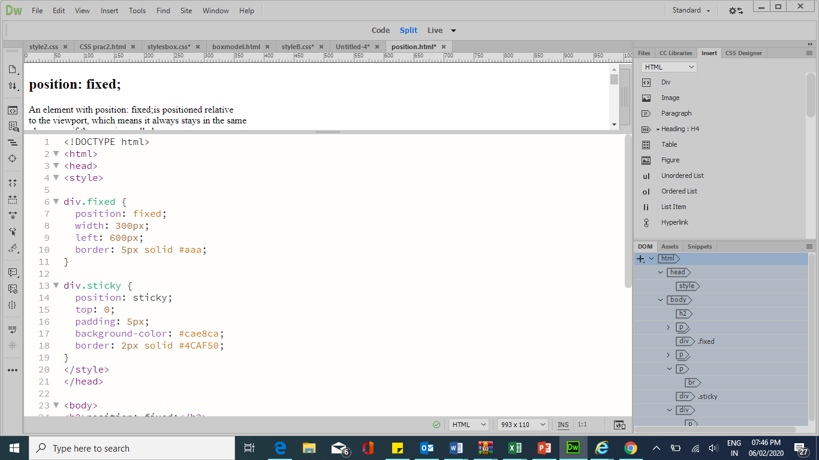
Example of position (fixed and Sticky)
Notes:
<!DOCTYPE html>
<html>
<head>
<style>
div.fixed {
position: fixed;
width: 300px;
left: 600px;
border: 5px solid #aaa;
}
div.sticky {
position: sticky;
top: 0;
padding: 5px;
background-color: #cae8ca;
border: 2px solid #4CAF50;
}
</style>
</head>
<body>
<h2>position: fixed;</h2>
<p>An element with position: fixed;is positioned relative <br>
to the viewport, which means it always stays in the same <br>
place even if the page is scrolled:</p>
<div class="fixed">
This div element has position: fixed;
</div>
<p>Try to <b>scroll</b> inside this frame to understand
<br>how sticky positioning works.</p>
<p>Note: IE/Edge 15 and earlier versions do not <br>support sticky position.</p>
<div class="sticky">I am sticky!</div>
<div style="padding-bottom:2000px">
<p>In this example, the sticky element sticks to the top of the page (top: 0),
when you reach its scroll position.</p>
</div>
</body></html>

Slide 38
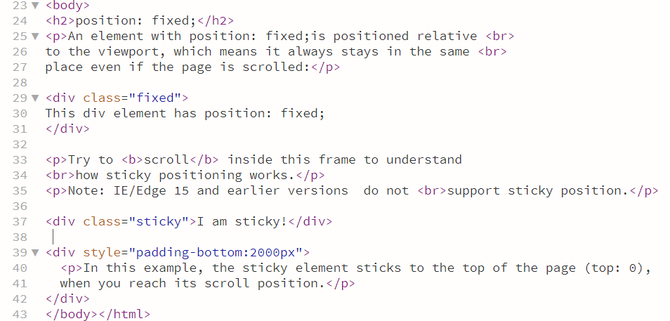
Example of position cont..

Slide 39
display
Display proprieties
- display: inline, block, inline-block and none
Element 1 | Element 2 | Element 3
{display: inline;}
Element 1 | Element 2 | Element 3
{display: inline-block;}
Element 1
Element 2
Element 3
Element 1
Element 3
Element 2 {display: none;}
{display: block;}

Slide 40
What is the different between inline & inline-block?
Display: inline-block: allows to set a width and height on the element.
Also, the top and bottom margins/paddings are respected
Display: inline ignore width , height , margins and paddings .
.Box1 { display: inline; width: 100px; height: 100px; padding: 5px; border: 1px solid blue; background-color: grey; }
.Box2{ display: inline-block; width: 100px; height: 100px; padding: 5px; border: 1px solid blue; background-color: yellow; }
box2
box1

Slide 41
Visibility
Visibility proprieties
- Visibility: visible | hidden
Element 1
Element 2
Element 3
Element 1
Element 3
{Visibility : visible;}
Element 2 {Visibility : hidden;}

Slide 42
Drop-Down Menus
Drop-down menus are a good way to provide navigation links without using a lot of screen space. In this section, we take a second look at the:
:hover pseudoclass
used to apply styles to an element when the mouse cursor is over it.
display property
allows a programmer to decide if an element is displayed as a block element, inline element, or is not rendered at all (none).

Slide 43
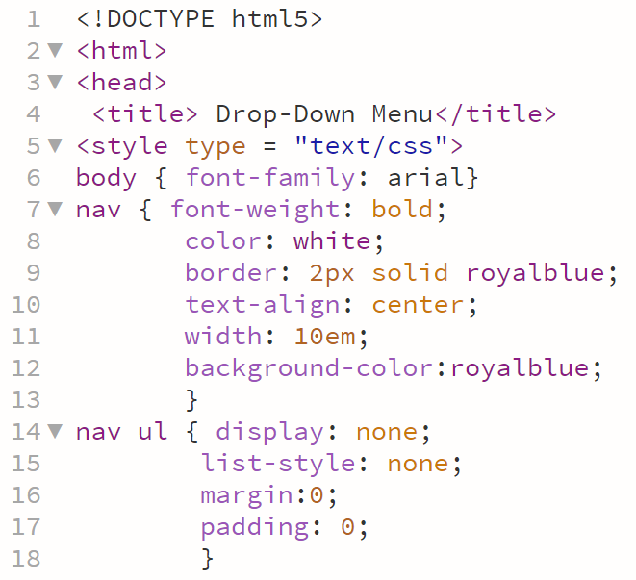
Drop-Down Menus Example
Notes:
<!DOCTYPE html5>
<html>
<head>
<title> Drop-Down Menu</title>
<style type = "text/css">
body { font-family: arial}
nav { font-weight: bold;
color: white;
border: 2px solid royalblue;
text-align: center;
width: 10em;
background-color:royalblue;
}
nav ul { display: none;
list-style: none;
margin:0;
padding: 0;
}
nav:hover ul {
display:block ;
}
nav ul li {
border-top: 2px solid royalblue;
background-color: white;
width: 10em;
color: black;
}
nav ul li:hover {
background-color:powderblue;
}
a {
text-decoration: none;
}
</style>
</head>
<body>
<nav> Menu
<ul>
<li><a href = "#">Home</a></li>
<li><a href = "#">News</a></li>
<li><a href = "#">Articles</a></li>
<li><a href = "#">Blog</a></li>
<li><a href = "#">Contact</a></li>
</ul>
</nav>
</body></html>

Slide 44
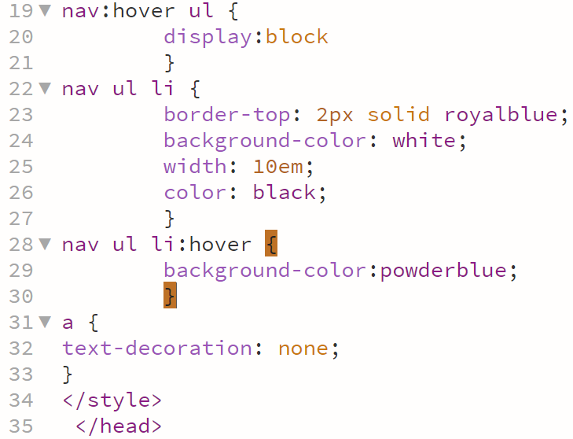
Drop-Down Menus Example cont..
Notes:
<!DOCTYPE html5>
<html>
<head>
<title> Drop-Down Menu</title>
<style type = "text/css">
body { font-family: arial}
nav { font-weight: bold;
color: white;
border: 2px solid royalblue;
text-align: center;
width: 10em;
background-color:royalblue;
}
nav ul { display: none;
list-style: none;
margin:0;
padding: 0;
}
nav:hover ul {
display:block
}
nav ul li {
border-top: 2px solid royalblue;
background-color: white;
width: 10em;
color: black;
}
nav ul li:hover {
background-color:powderblue;
}
a {
text-decoration: none;
}
</style>
</head>
<body>
<nav> Menu
<ul>
<li><a href = "#">Home</a></li>
<li><a href = "#">News</a></li>
<li><a href = "#">Articles</a></li>
<li><a href = "#">Blog</a></li>
<li><a href = "#">Contact</a></li>
</ul>
</nav>
</body></html>

Slide 45
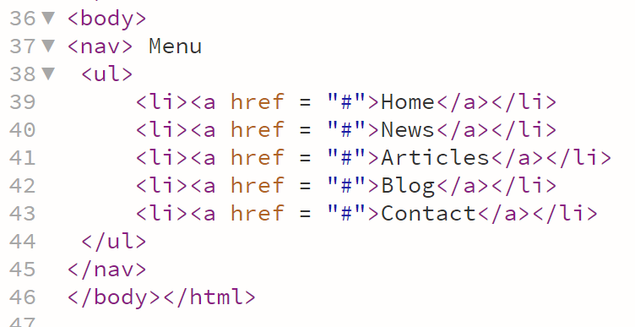
Drop-Down Menus Example cont..
Notes:
<!DOCTYPE html5>
<html>
<head>
<title> Drop-Down Menu</title>
<style type = "text/css">
body { font-family: arial}
nav { font-weight: bold;
color: white;
border: 2px solid royalblue;
text-align: center;
width: 10em;
background-color:royalblue;
}
nav ul { display: none;
list-style: none;
margin:0;
padding: 0;
}
nav:hover ul {
display:block
}
nav ul li {
border-top: 2px solid royalblue;
background-color: white;
width: 10em;
color: black;
}
nav ul li:hover {
background-color:powderblue;
}
a {
text-decoration: none;
}
</style>
</head>
<body>
<nav> Menu
<ul>
<li><a href = "#">Home</a></li>
<li><a href = "#">News</a></li>
<li><a href = "#">Articles</a></li>
<li><a href = "#">Blog</a></li>
<li><a href = "#">Contact</a></li>
</ul>
</nav>
</body></html>

Slide 46
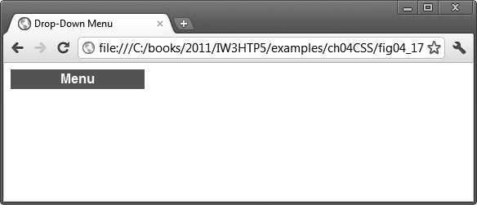
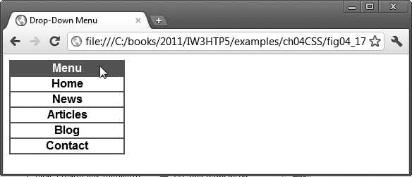
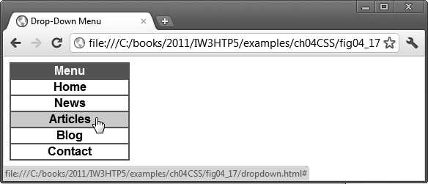
Drop-Down Menus Example (8) in the browser
A
B
C
A collapsed menu
b) A drop-down menu
is displayed when the
mouse cursor is hovered over Menu
c) Hovering the mouse
cursor over a menu link
highlights the link

Slide 47
How to master centring the elements?
The easiest wat to centering elements by using text-align property inside the parent container (which is the BODY in the most cases)
Body{
Text-align: center;
}
//this will center all the paragraphs ,images and everything inside the page as long as they are inline, or block element and their width is 100% of the page.
In case we have a block element, and their width was not 100% of the page. How to centre the element ????????
margin:0 auto
Notes:
To more understanding:
1- Ask the students to add 2 headers and 1 img.
2- Add style for the body:
Body{
Text-align: center;
}
observe what happened ?
4- Aske the students to change one of the headers width to 50%
observe what happened ?

Slide 48
Some of the most popular CSS Properties
Property | Description
font-family | Specifies the name of the font to use
font-size | Specifies a 14-point font
Font-width | weight of font. determines if text is bold. valid values are normal, bold, bolder, or 100 - 900. Optional property in font shorthand
font-style | Style of the font. valid values are either italic or normal. Defaults to normal. Optional property in font shorthand
text-transform | is used to specify uppercase and lowercase letters in a text.
display | The display property specifies if/how an element is displayed.

Slide 49
Some of the most popular CSS Properties
property | Description
border | allow you to specify the style, width, and color of an element's border.
border-radius | is used to add rounded borders to an element.
border-width | width of the border. Same units as width and height
border-style | style of the border. Usual values are solid and dashed.
border-color | color of the border. Hex, and rgb values can be used.
Box-sizing | allows us to include the padding and border in an element's total width and height.
Position | specifies the type of positioning method used for an element. values(static, relative, fixed, absolute, sticky)

